Slide 1
14th Hydra Shipping Conference
Hydra, September 16, 2023
Outlook for Fossil Fuels and their Impact on Shipping
A Presentation by Costis Stambolis
Chairman and Executive Director,
Institute of Energy for SE Europe (IENE)
ΙNSTITUTE OF ENERGY
FOR SOUTH EAST EUROPE

Slide 2
Introduction
Crude oil and petroleum products, Liquefied Natural Gas (LNG) and coal constitute the vast majority of energy cargoes transported daily by ships all over the world.
Looking at the statistics for 2022, we see that fossil fuels correspond to 82% of the final global energy consumption.
In view of the fact that Greek owned vessels transport large amounts of energy cargoes, roughly corresponding to 50% of global volumes, it is of interest to know the mid- and long-term outlook of the above natural resources.
Hence, based on data provided by the International Energy Agency (IEA), BP, the Energy Institute and the EIA, we take a look on the mid- and long-term prospects and their impact on shipping.
Given the pressure from international bodies, including the EU and the United Nations, and the huge public mobilisation to enforce an energy transition, based exclusively on Renewable Energy Sources, Hydrogen, Electric Vehicles and other so called clean energy sources, including nuclear power, the impression has been created that it only a matter of time for fossil fuels to become redundant as in very few years, latest by 2040, the world will not need them as everything will run on electricity generated by RES and nuclear power.
Is the above a pragmatic scenario? Are we likely to soon see the end of seaborne transportation of oil, gas and coal? The answer is clearly no and one has only to look at some interesting data on global oil consumption, going back to 1973 and comparing it with 2022, to realise that energy transition does not happen in five, ten or twenty years. In 1973, fossil fuels were covering 87% of global energy needs, whereas in 2022 they were responsible for 82% (Despite more than $5 trillion investment and heavy subsidies over the last 15 years or so).

Slide 3
Share of World Total Energy Supply by Source, 1973 and 2019
Source: IEA Key World Energy Statistics 2022

Slide 4
Global Energy Consumption and Shares of Global Primary Energy
Source: Energy Institute Statistical Review of World Energy 2023

Slide 5
Global Final Energy Consumption by Scenarios by 2050
Source: BP Energy Outlook 2023

Slide 6
As Energy Transition Policies Gather Pace, the Future of Global Energy Mix is Dominated by Four Trends: Declining Role For Hydrocarbons, Rapid Expansion in Renewables, Increasing Electrification and Growing Use of Low-carbon Hydrogen
Source: BP Energy Outlook 2023

Slide 7
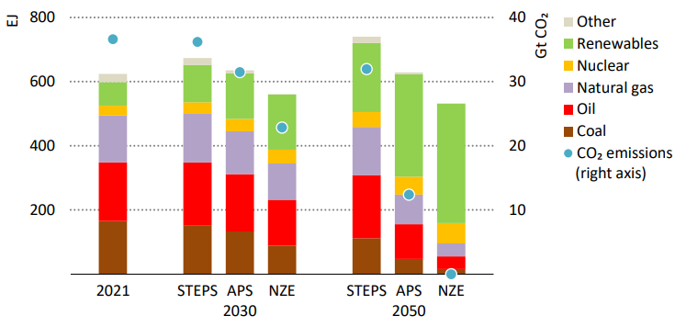
IEA: Total Energy Supply by Fuel and CO2 Emissions by Scenario
Source: IEA World Energy Outlook 2022

Slide 8
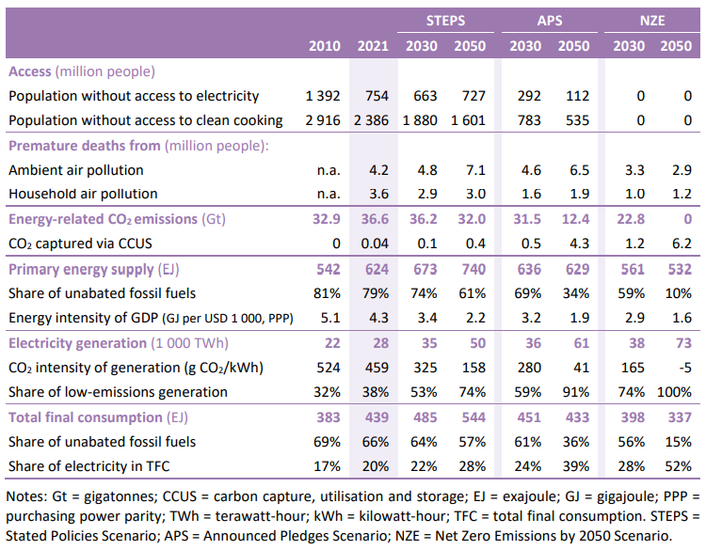
IEA: Key Energy Indicators by Scenario, 2010-2050
Source: IEA World Energy Outlook 2022

Slide 9
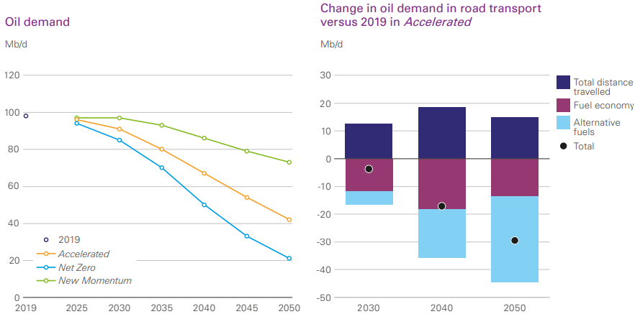
The Future of Global Oil Demand
Source: BP Energy Outlook 2023

Slide 10
IEA: Global Oil Demand by Region (mb/d), 2019-2028
Source: IEA Oil 2023

Slide 11
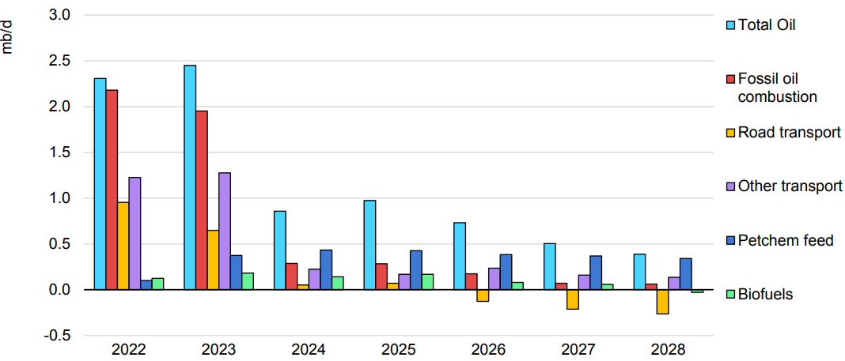
Annual Global Oil Demand Growth, 2022-2028
Source: IEA Oil 2023

Slide 12
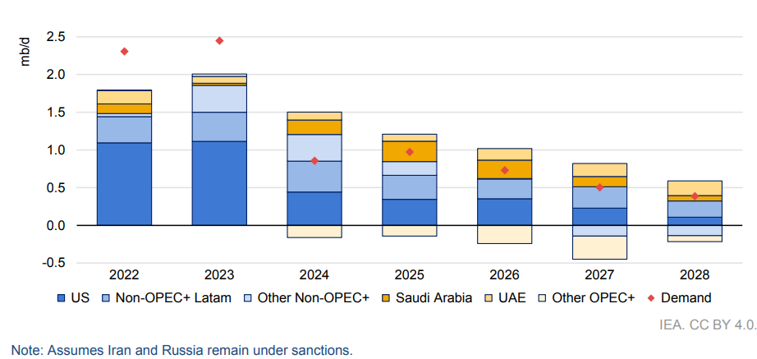
Global Oil Supply Capacity and Demand Forecast, Y-o-Y Change, 2022-2028
Source: IEA Oil 2023

Slide 13
The Ever Shifting Peak Oil
Ever since the coming of the oil age, there has been a fear of an impeding crisis concerning the availability of the resource due to uncontrolled demand
Later on, after the war, the fear returned as global oil consumption kept rising and governments started to worry about resource depletion
Thanks to modern exploration methods and the discovery of substantial oil fields beyond the Middle East and the USA, this fear subsided as oil companies were able to report increased proved reserves on a sustainable basis
Fast forward in the 21st century and the discussion on peak oil has returned on a new basis. The issue is now how soon will oil demand (and consequently oil production) start to recede so as to help lower greenhouse emissions. The same argument applies to natural gas
Over the last 20 years or so, since Climate Change started to determine energy policies, the IEA and other organisations speculated as to when peak oil could be achieved setting one target after the other. First it was 2020, then it was 2025, 2028, 2030 and so forth.
Such arbitrary targets systematically underestimated the developing world’s insatiable thirst for oil and gas as they are still (together with coal) the cheapest and most easily available forms of energy to satisfy rising energy needs. With RES contributing more energy but which is channeled almost exclusively for power generation.
Latest findings as reported by the IEA in its forthcoming flagship report, World Energy Outlook 2023, show that peak oil may not actually be reached before 2040 by which time production is expected to plateau.

Slide 14
China is Driving Global EV Sales (LHS) and Oil Demand Set to Plateau (RHS)
Source: IEA

Slide 15
Crude Oil Prices, 1862-2022
Source: Energy Institute Statistical Review of World Energy 2023

Slide 16
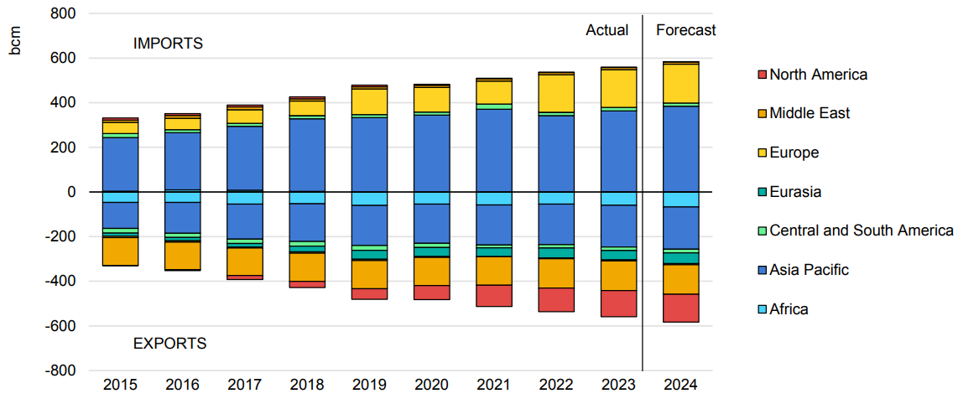
Global LNG Imports and Exports by Region, 2015-2024

Slide 17
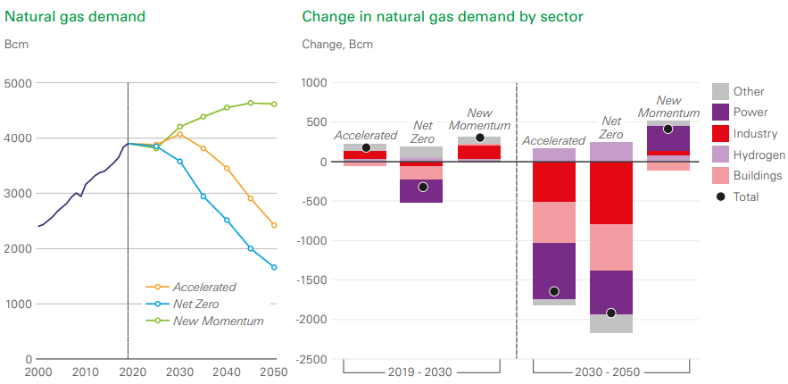
The Future of Global Gas Demand
Source: BP Energy Outlook 2023

Slide 18
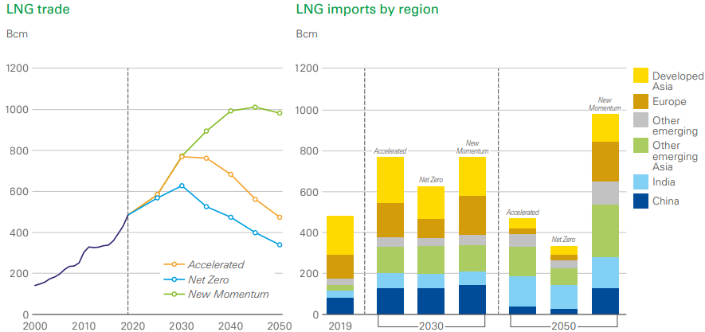
The Future of Global LNG Trade
Source: BP Energy Outlook 2023

Slide 19
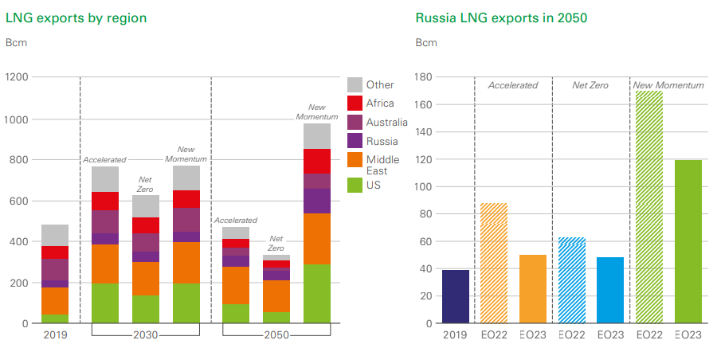
LNG Exports are Dominated by the US and the Middle East
Source: BP Energy Outlook 2023

Slide 20
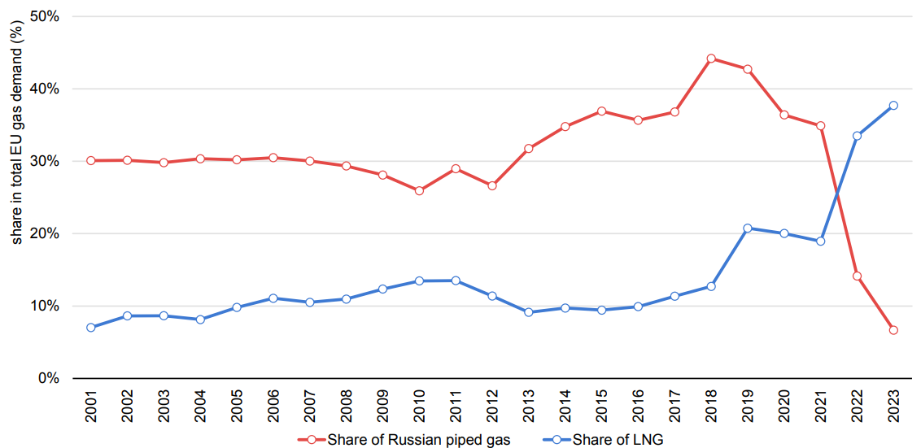
The Share of LNG and Russian Piped Gas in the EU’s Gas Demand (2001-2023)

Slide 21
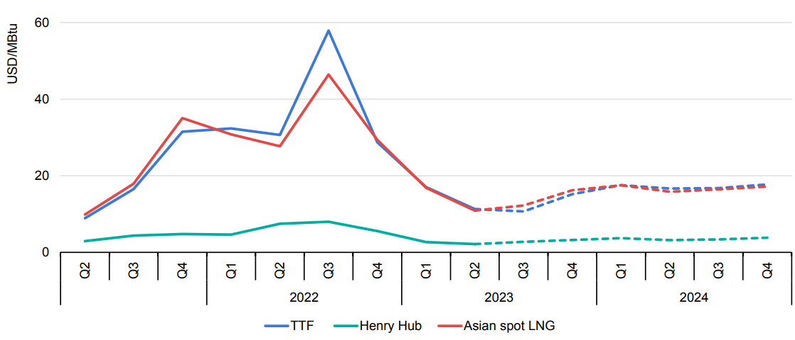
Main Spot and Forward Natural Gas Prices, 2020-2024
Source: BP Energy Outlook 2023

Slide 22
Coal Demand at Record Level, 2000-2022
Source: IEA

Slide 23
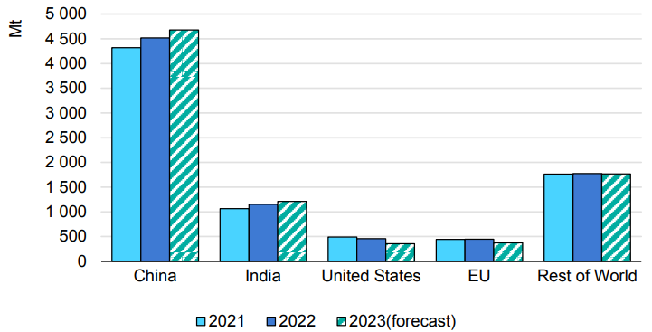
Global Coal Consumption, 2021-2023
Source: IEA Coal Market Update (July 2023)

Slide 24
Coal Supply by Scenario, 2010-2050
Source: IEA World Energy Outlook 2022

Slide 25
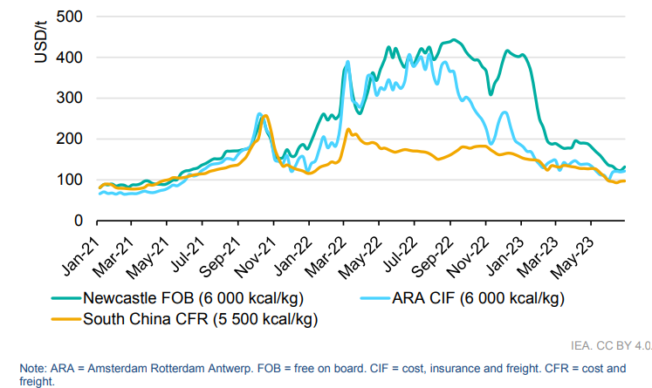
Thermal Coal Price Markers, 2021-2023
Source: IEA Coal Market Update (July 2023)

Slide 26
Liquefaction Capacity Growth Vs LNG Global Fleet Count Growth, 2011-2022
Source: IGU LNG Report 2023

Slide 27
Global Active LNG Fleet and Orderbook by Delivery Year and Average Capacity, 1991-2028
Source: IGU LNG Report 2023

Slide 28
Global LNG Shipping
Source: IGU LNG Report 2023

Slide 29
Alternative Fuel Uptake in the World Fleet by Number of Ships and Gross Tonnage
Source: DNV Maritime Forecast 2050

Slide 30
DNV’s 24 Scenarios for the Maritime Energy Mix in 2050
Source: DNV Maritime Forecast 2050

Slide 31
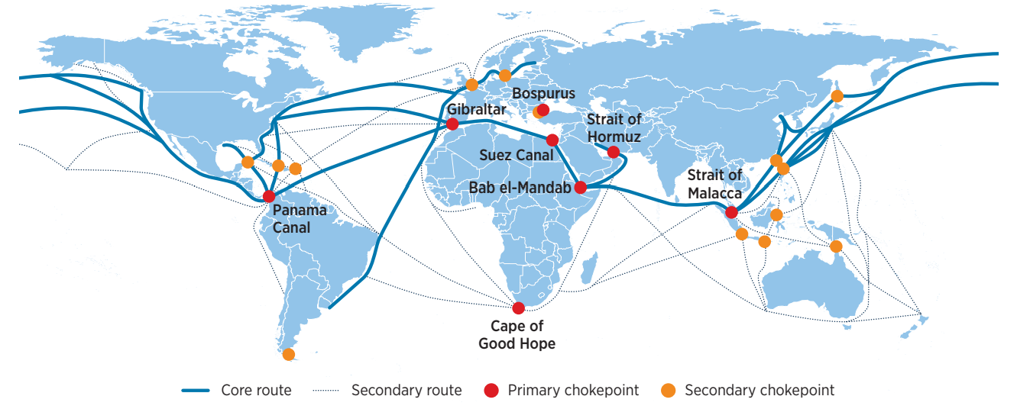
Main Maritime Shipping Traffic Routes
Source: IRENA Decarbonising Shipping 2021

Slide 32
Concluding Remarks
Efforts by governments and international organisations to fast track energy transition by imposing emission inspired change of fuel in industries, transportation, buildings and shipping have not been successful in curtailing demand for oil, gas and coal. On the contrary, we see a rise in demand.
Peak oil demand is now forecasted beyond 2040 while gas demand may not climax until a little later, and so we can take a breath.
In any event, there are divergent views among forecasters and nobody really knows when exactly we might see peak fossil fuel demand happening.
It safe to assume that beyond 2050 the global energy mix will shift towards greater electricity input. This means that over the 20-25 years we shall need more vessel capacity to transport energy related commodities. That means more oil tankers and a lot more LNG and special cargo vessels.
There are opportunities in new type of special type vessels such as CO2, Hydrogen, Methanol, Ammonia carriers as CCUS technologies take hold.
In view of increased environmental regulation and the weighing of ESG criteria in shipping and chartering operations, a clear direction will be towards new builds.
The extra costs involved in the building and operation of vessels which comply with the new low carbon criteria will be covered by improved efficiencies in the management and running of vessels (e.g. lowering of fuel costs, increased automation, etc.).
Greek shipowners are well placed to take advantage of the new global energy and environmental order. By constantly modernising their fleets and showcasing responsible ship management (by expertly managing HR and environmental issues) and versatility in operations Greek shipowners will continue to compete successfully in a most challenging global environment.

